Slide 1

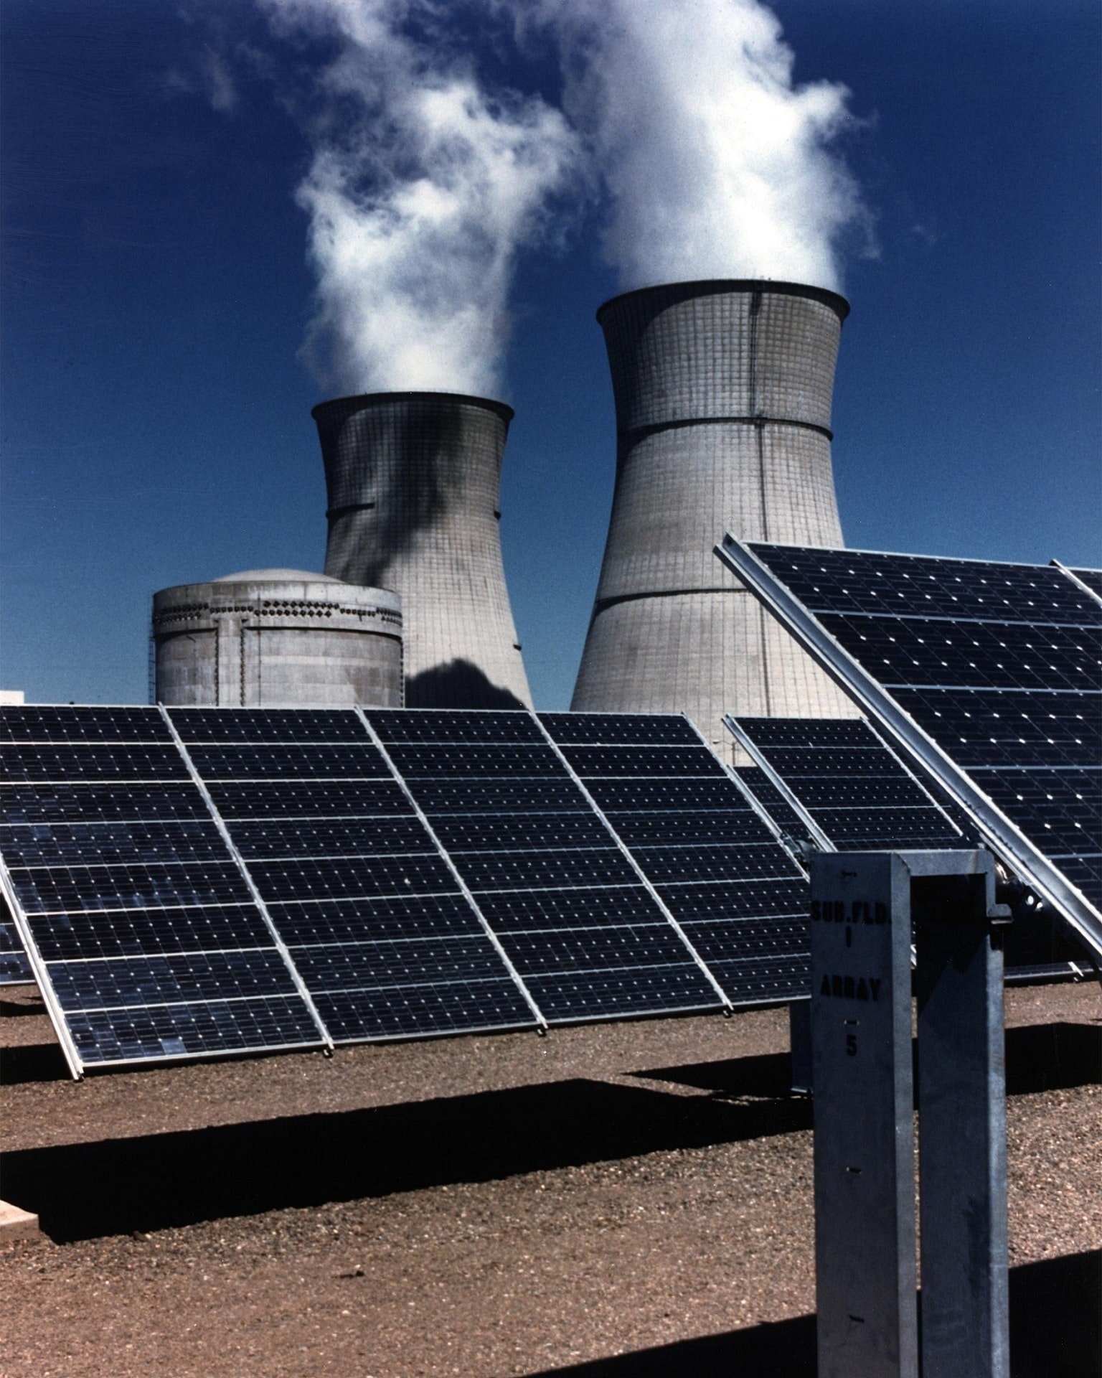

EDSA Climate Change Belief Analysis Our Machine Learning model has learnt how to classify tweets

Slide 2
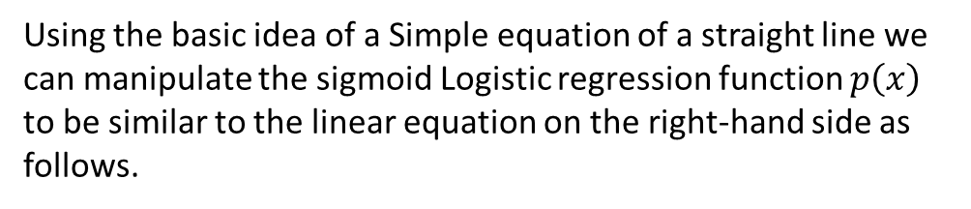

Introduction
Team TS5 has been tasked with a Classification problem hosted within a Kaggle class on classifying tweets according to climate sentiments
Machine Learning is a powerful Technique within the field of data science and it can be described in 3 fields , Supervised Learning , Un-supervised Learning and Re-Enforcement Learning but for the purpose of this challenge we shall apply the techniques of Supervised Learning more specifically on Classification
Using the basic idea of a Simple equation of a straight line we can manipulate the sigmoid Logistic regression function $p\left(x\right)$ to be similar to the linear equation on the right-hand side as follows.
$$\log{( \frac{p\left(x\right)}{1−p\left(x\right)} )}=β_{0}+β_{1}(x)$$

Slide 3
Problem Statement
We have been tasked to determine how people perceive climate change and whether they believe it is man-made or not?

Slide 4

Steps
Project Life Cycle
Data Collection
Data Cleaning
Exploratory Data Analysis
Model Building

Slide 5
Approach
After Cleaning data we will take a deeper look into our data using Exploratory Data Analysis
Using Feature selection and the powerful NLTK library to check which training data for tweets is more suitable to yield the best performing models

Slide 6
Data
description
Each tweet is labelled as one of the following classes represented as Sentiments:
Class Description 2 News: the tweet links to factual news about climate change
Class Description 1 Pro: the tweet supports the belief of man-made climate change
Class Description 0 Neutral: the tweet neither supports nor refutes the belief of man-made climate change
Class Description -1 Anti: the tweet does not believe in man-made climate change

Slide 7
Story Line
Suppose there's a new Tech start-up company that has built an amazing proto-type of Hybrid Solar Panels.
The CEO of the Tech start-up is ready to distribute the new solar panels to the market, but the problem is he hasn’t figured out he’s clientele yet, so he has asked us team TS5 to help him be able to find twitter users who will most likely be interested in purchasing the new Hybrid solar panels.
Thanks to Canada Foundation and the University of Waterloo Team TS5 was able to obtain the climate change twitter sentiments data in which they could use to solve the classification Problem by training a Machine Learning Model.

Slide 8
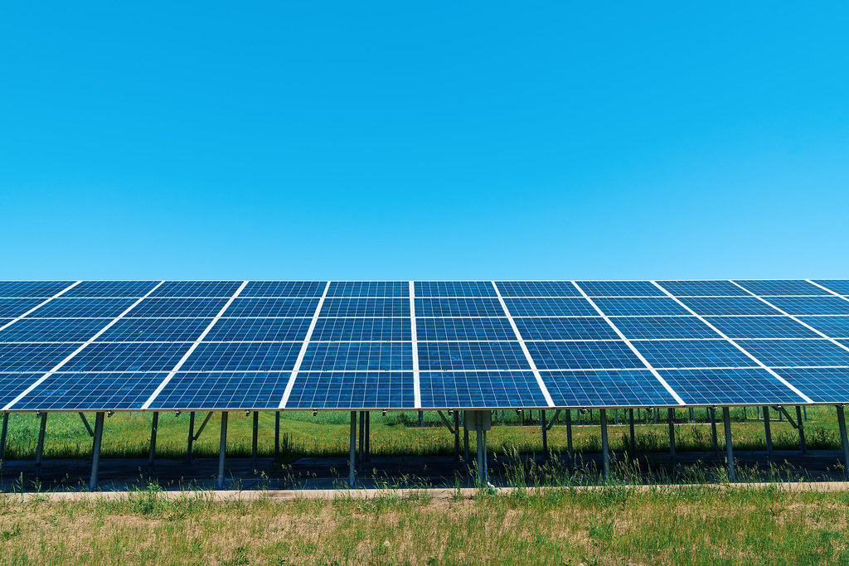






Hi
I am the Ceo

Slide 9
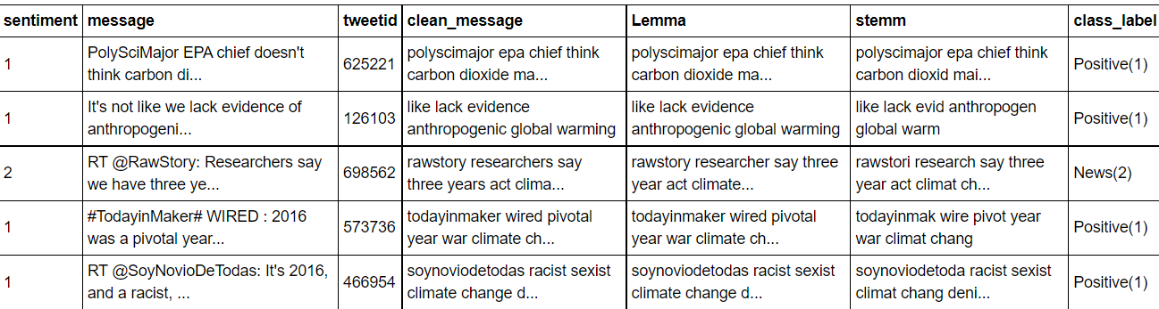


They took my data set and cleaned it , in order to perform analysis
Lucky for me , Team TS5 will apply their machine learning skills to solve my problem
This Photo by Unknown Author is licensed under CC BY

Slide 10
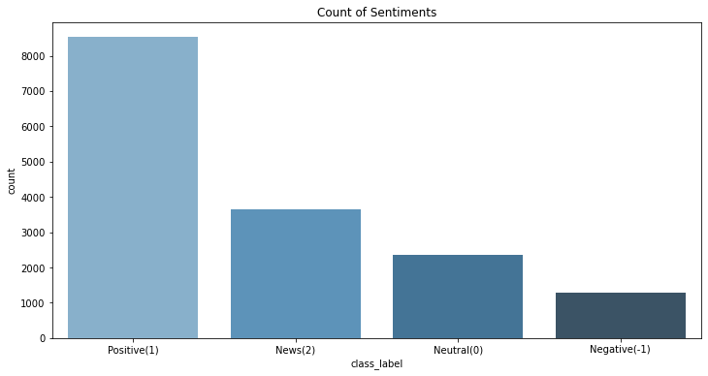
They got me some descriptive statistics
This Photo by Unknown Author is licensed under CC BY

Slide 11
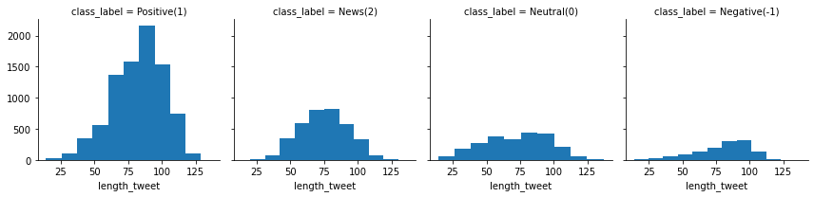
Here is the skewness distribution amongst my predictor variables
This Photo by Unknown Author is licensed under CC BY

Slide 12
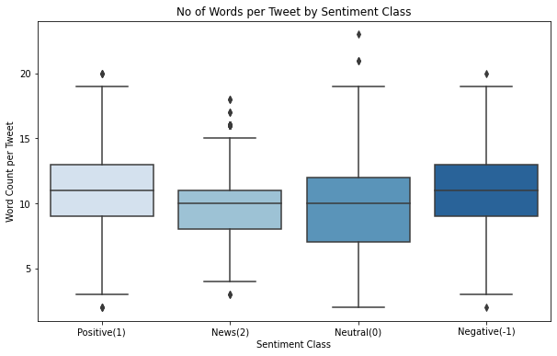
Here are the Boxplots for the
Twitter sentiments
This Photo by Unknown Author is licensed under CC BY

Slide 13
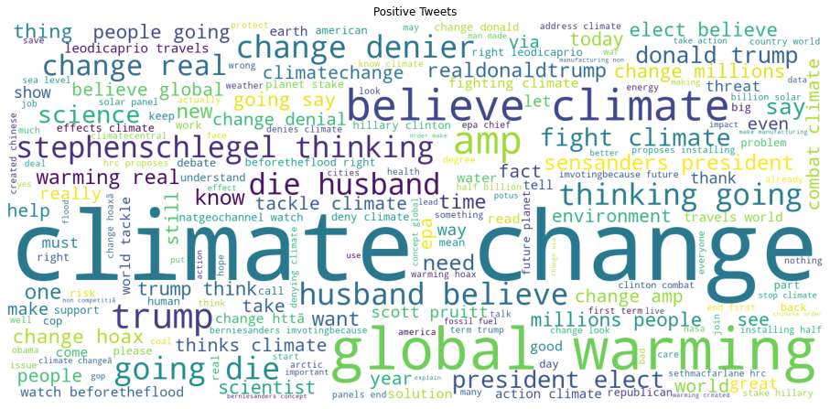
Team TS5 provided a Wordcloud for the Positive Tweet Sentiment
This Photo by Unknown Author is licensed under CC BY

Slide 14
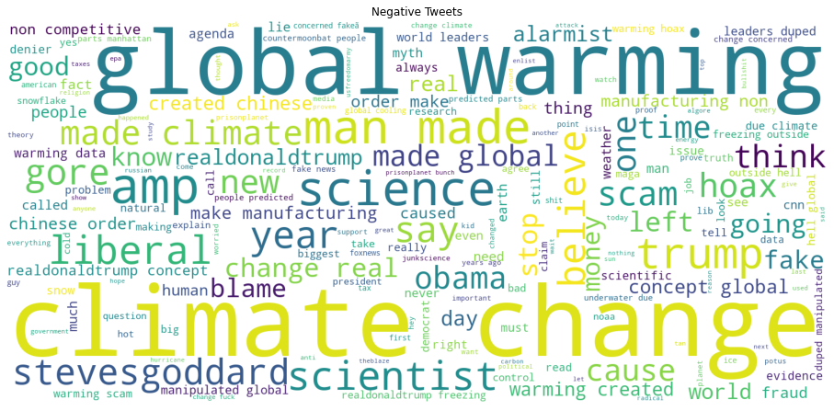
Team TS5 provided a Wordcloud for the Negative Tweet Sentiment
This Photo by Unknown Author is licensed under CC BY

Slide 15
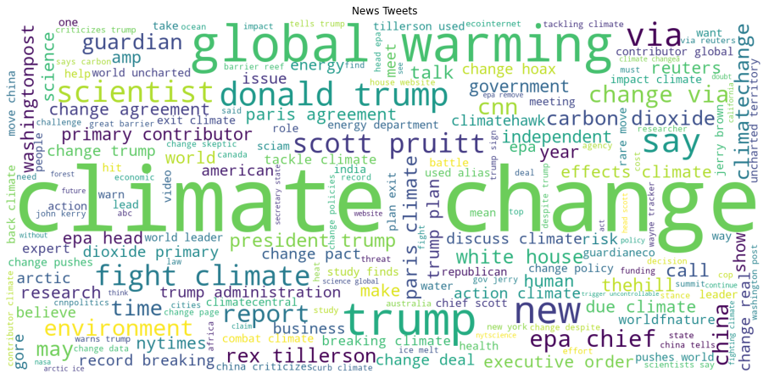
Team TS5 provided a Wordcloud for the Negative Tweet Sentiment
This Photo by Unknown Author is licensed under CC BY

Slide 16
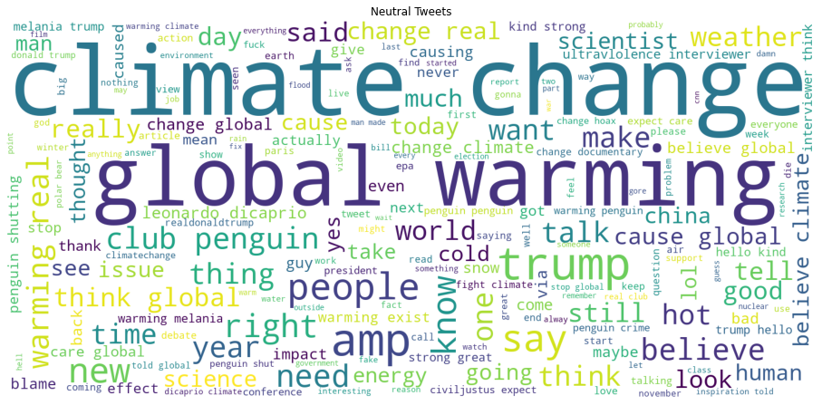
Team TS5 provided a Wordcloud for the Negative Tweet Sentiment
This Photo by Unknown Author is licensed under CC BY

Slide 17
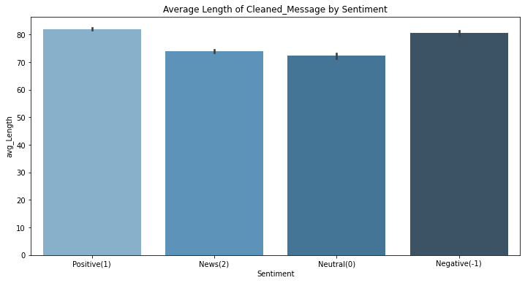
Average Length of tweet sentiment
This Photo by Unknown Author is licensed under CC BY

Slide 18
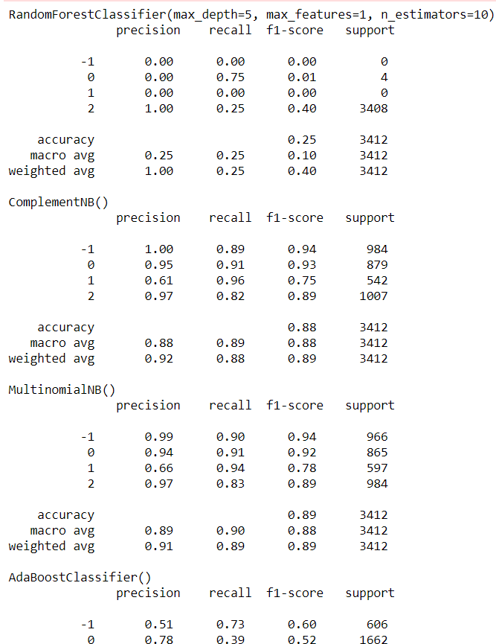
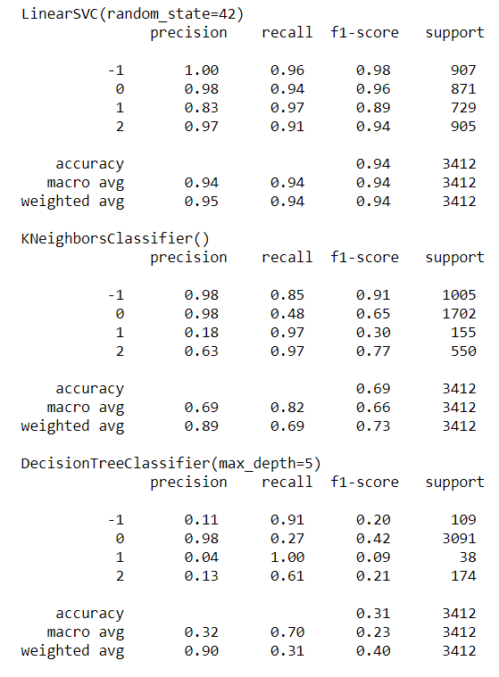
Here are our Models
This Photo by Unknown Author is licensed under CC BY

Slide 19
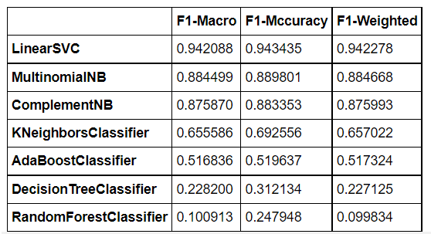
There are many other models they tested out , lets summarize them in this table
This Photo by Unknown Author is licensed under CC BY

Slide 20
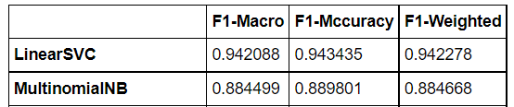
Lets take a look at The 2 best performing Models
The LinearSVC and The Multinomial Naïve-Bayes
This Photo by Unknown Author is licensed under CC BY

Slide 21

Design Choices
We mentioned earlier on About the Project Life Cycle
Moreover towards the last two sections
Exploratory Data Analysis
Model Building
This Photo by Unknown Author is licensed under CC BY-SA

Slide 22
Findings
Publish more information about climate change to attract some of the neutral class who might not be exposed to the idea of climate change in order to grow more clientele.
He can increase the supply of the solar panels since it can match the demand of the people who are for decreasing their carbon footprint
Here are the insights we found
Now that we have went in deep into our Big data

Slide 23

Our LinearSVC gave us the best performing model
With an F1 score of 0.92
Conclusion
Most likely my clientele would be people who are well informed with climate change, environmentalists or Tech-savy so thanks TS5 with your service
This Photo by Unknown Author is licensed under CC BY-SA

Slide 24
Summary
The LinearSVC is our best performing model
The methods used within this challenge are not limited and also the analysis still has more vacancy for a deeper dive Hence it is possible to obtain much more accurate models

Slide 25
Refence page
analyticsvidhya: https://www.analyticsvidhya.com/blog/2018/07/hands-on-sentiment-analysis-dataset-python/
towardsdatascience: https://towardsdatascience.com/how-to-efficiently-remove-punctuations-from-a-string-899ad4a059fb
codegrepper: https://www.codegrepper.com/code-examples/python/pandas+series+remove+punctuation
https://stackoverflow.com/questions/54396405/how-can-i-preprocess-nlp-text-lowercase-remove-special-characters-remove-numb

